Slide 1
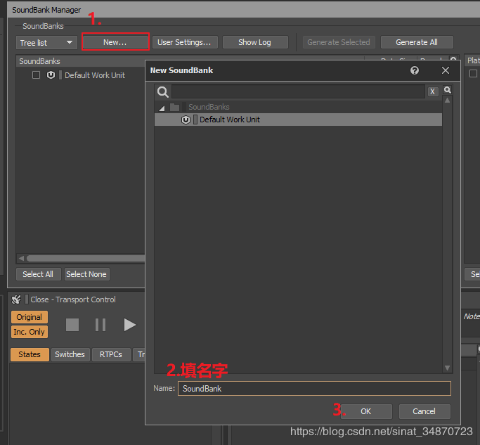
Integrating Wwise and Unity – a Visual Guide
Abby Pryor
This Photo by Unknown Author is licensed under CC BY-SA

Slide 2
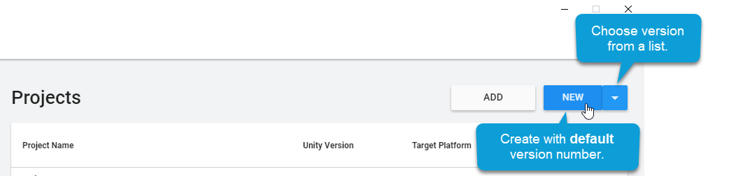
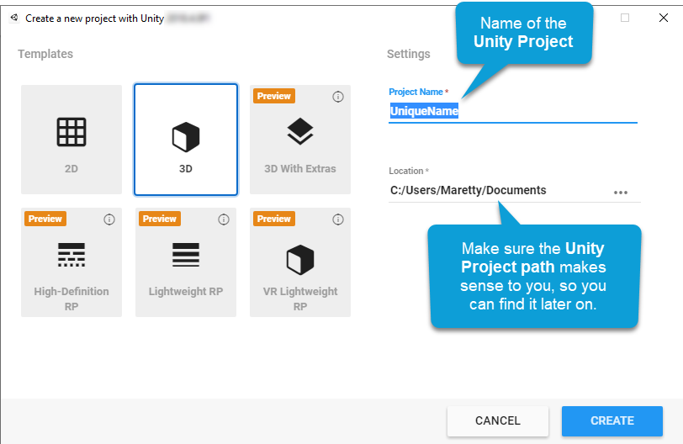
Create a New Unity Project
Open Unity
Click New
Name Project
Click Create
Once open, save and close.

Slide 3


Integrate into a Wwise Project
Open the Wwise Launcher. As one of the most commonly used game engines, Unity has its own tab for associated projects.
In the Wwise Launcher menu, select Unity.
Click Integrate Wwise into Project.
Click Integrate, choose platforms, and accept terms.

Slide 4
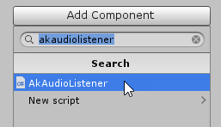
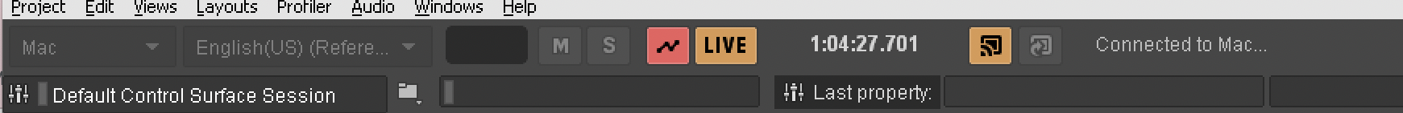
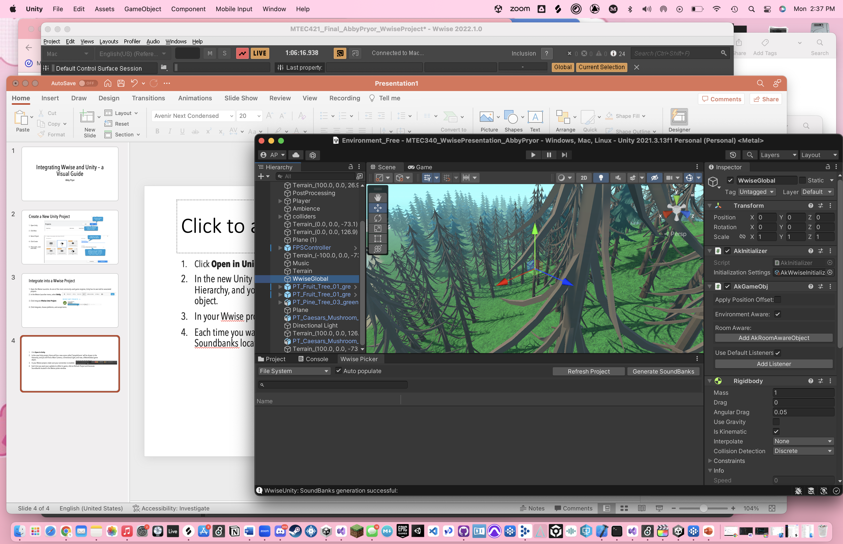
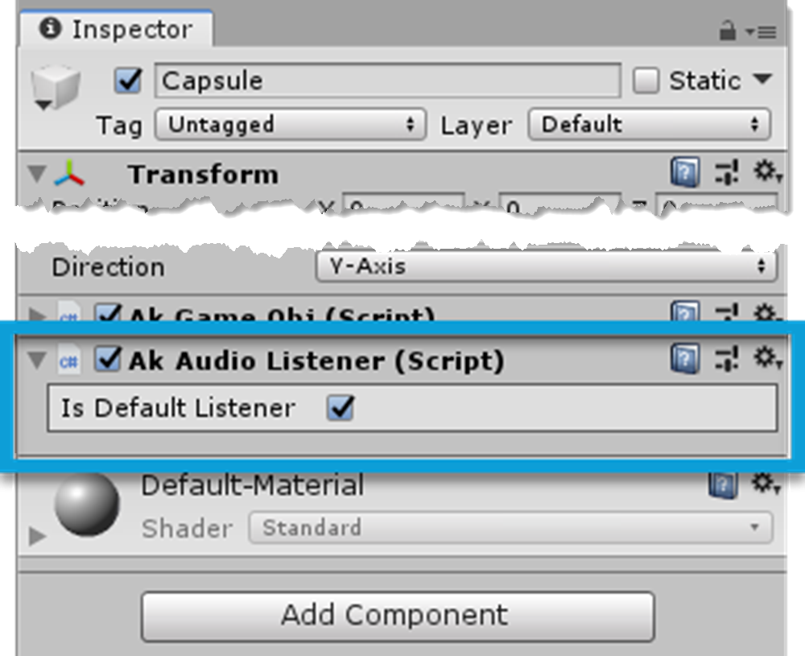
Now What?
Click Open in Unity.
In the new Unity project, there will be a new scene called 'SampleScene' will be shown in the Hierarchy, and you will find a Main Camera, a Directional Light, and now, a WwiseGlobal game object.
In your Wwise project, make sure your connection is enabled. It won’t work without establishing the connection. Unity will tell you whenever it is not connected to the Wwise project.
Each time you want your updates to reflect in game, click on Refresh Project and Generate Soundbanks located in the Wwise picker window.
You will need to add Wwise components on your GameObjects (begins with Ak) in order to hear any sound.

